Slide 1
Software Quality Assurance
Dr. Seemab Latif
Lecture No. 13
20th Decemnber, 2010

Slide 2
Review of Previous Lecture
One creates a “working version of the system” by putting the modules together in an incremental manner while performing tests to uncover different types of errors associated with interfacing.
Next, we explored various levels of granularities in system integration testing: intrasystem testing, intersystem testing, and pairwise testing.
We then examined five types of commonly used system integration techniques: topdown, bottomup, sandwich, bigbang, and incremental. We compared those techniques in detail. The incremental technique is widely used in the industry.
We provided a framework of an integration test plan. The following categories of tests, which are included in an integration test plan, were discussed in detail: interface integrity tests, functional validity tests, end-to-end validity tests, pairwise validity tests, interface stress tests, and endurance tests.
Finally, we described the integration of OTS components with other components. An organization, instead of developing a software component from scratch, may decide to purchase a COTS software from a third-party source and integrate it with its own software system.

Slide 3
System Testing
The objective of system-level testing, also called system testing, is to establish whether an implementation conforms to the requirements specified by the customers.
It takes much effort to guarantee that customer requirements have been met and the system is acceptable.
As integrated systems, consisting of both hardware and software components, are often used in reality, there is a need to have a much broader view of the behaviour of the systems.

Slide 4
System Testing
For example, a telephone switching system not only is required to provide a connection between two users but also is expected to do so even if there are many ongoing connections below a certain upper limit. When the upper limit on the number of simultaneous connections is reached, the system is not expected to behave in an undesired manner.

Slide 5
Test Categories
In this lecture, different categories of tests in addition to the core functionality test will be identified. Identifying test categories brings us the following advantages:
Test engineers can accurately focus on different aspects of a system, one at a time, while evaluating its quality.
Test engineers can prioritize their tasks based on test categories. For example, it is more meaningful and useful to identify the limitations of a system only after ensuring that the system performs all basic functions to the test an engineer’s satisfactions. Therefore, stress tests, which thrive to identify the limitations of a system, are executed after functionality tests.
Planning the system testing phase based on test categorization lets a test engineer obtain a well-balanced test suite. Practical limitations make it difficult to be exhaustive, and economic considerations may restrict the testing process from continuing any further. However, it is important to design a balanced test suite, rather than an unbalanced one with many test cases in one category and no tests in another.

Slide 6
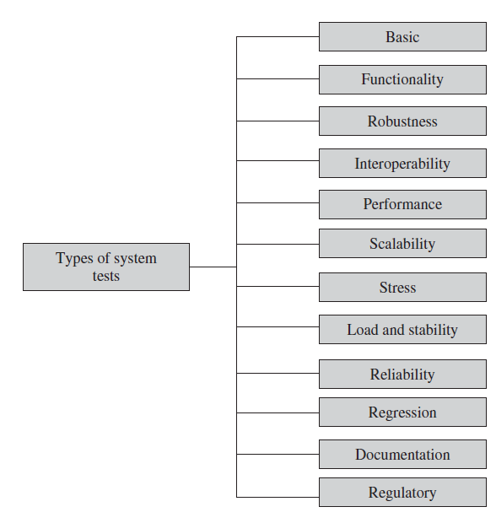
Taxonomy of System Tests
Provide an evidence that the system can be installed, configured, and brought to an operational state.
Provide comprehensive testing over the full range of the requirements within the capabilities of the system.
Determine how well the system recovers from various input errors and other failure situations.
Determine whether the system can interoperate with other third-party products
Measure the performance characteristics of the system, for example, throughput and response time, under various conditions.
Determine the scaling limits of the system in terms of user scaling, geographic scaling, and resource scaling.
Put a system under stress in order to determine the limitations of a system and, when it fails, to determine the manner in which the failure occurs.
Provide evidence that the system remains stable for a long period of time under full load.
Measure the ability of the system to keep operating for a long time without developing failures.
Determine that the system remains stable as it cycles through the integration of other subsystems and through maintenance tasks
Ensure that the system’s user guides are accurate and usable.
Ensure that the system meets the requirements of government regulatory bodies in the countries where it will be deployed.

Slide 7
Taxonomy of System Tests

Slide 8
1. Basic Tests
The basic tests give a first evidence that the system is ready for more rigorous tests. These tests provide limited testing of the system in relation to the main features in a requirement specification.
The objective is to establish that there is sufficient evidence that a system can operate without trying to perform thorough testing.
Basic tests are performed to ensure that commonly used functions, not all of which may directly relate to user-level functions, work to our satisfaction.
We emphasize the fact that test engineers rely on the proper implementation of these functions to carry out tests for user-level functions.

Slide 9
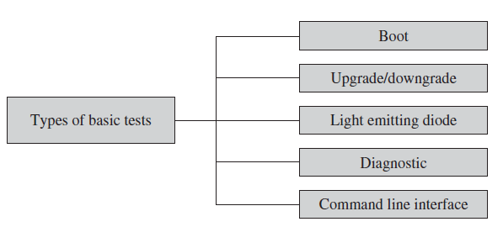
Basic Tests
The following are the major categories of subsystems whose adequate testing is called the basic test.
Boot Tests
Upgrade/Downgrade Tests
Light Emitting Diode Tests
Diagnostic Tests
Command Line Interface Tests

Slide 10
a. Boot Tests
Boot tests are designed to verify that the system can boot up its software image (or build) from the supported boot options.
The boot options include booting from ROM, FLASH card, and PCMCIA (Personal Computer Memory Card International Association) card.
The minimum and maximum configurations of the system must be tried while booting. For example, the minimum configuration of a router consists of one line card in its slots, whereas the maximum configuration of a router means that all slots contains line cards.

Slide 11
b. Upgrade/Downgrade Tests
Upgrade/downgrade tests are designed to verify that the system software can be upgraded or downgraded (rollback) in a graceful manner from the previous version to the current version or vice versa.
Suppose that the system is running the (n −1)th version of the software build and the new nth version of the software build is available. The question is how one upgrades the build from the (n −1)th version to the nth version.
An upgradation process taking a system from the (n −1)th version to the nth version may not be successful, in which case the system is brought back to the (n −1)th version.
Tests are designed in this subgroup to verify that the system successfully reverts back, that is, rolls back, to the (n −1)th version.
An upgradation process may fail because of a number of different conditions: user-invoked abort (the user interrupts the upgrade process), in-process network disruption (the network environment goes down), in-process system reboot (there is a power glitch), or self-detection of upgrade failure (this is due to such things as insufficient disk space and version incompatibilities).

Slide 12
c. Light Emitting Diode Tests
The LED (light emitting diode) tests are designed to verify that the system LED status indicators function as desired.
The LEDs are located on the front panels of the systems. These provide visual indication of the module operational status.
For example, consider the status of a system chassis: Green indicates that the chassis is operational, off indicates that there is no power, and a blinking green may indicate that one or more of its sub-modules are faulty.
The LED tests are designed to ensure that the visual operational status of the system and the sub-modules are correct.
Examples of LED tests at the system and subsystem levels are as follows:
System LED test: green = OK, blinking green = fault, off = no power.
Ethernet link LED test: green = OK, blinking green = activity, off = fault.
Cable link LED test: green = OK, blinking green = activity, off = fault.
User defined T1 line card LED test: green = OK, blinking green = activity, red = fault, off = no power.

Slide 13
d. Diagnostic Tests
Diagnostic tests are designed to verify that the hardware components (or modules) of the system are functioning as desired. It is also known as the built-in self-test (BIST). Diagnostic tests monitor, isolate, and identify system problems without manual troubleshooting. Some examples of diagnostic tests are as follows:
Power-On Self-Test (POST): This is a set of automatic diagnostic routines that are executed during the boot phase of each sub-module in the system. The POSTs are intended to determine whether or not the hardware is in a proper state to execute the software image. It is not intended to be comprehensive in the analysis of the hardware; instead, it provides a high level of confidence that the hardware is operational. The POSTs execute on the following kinds of elements:
Memory
Address and data buses
Peripheral devices

Slide 14
Diagnostic Tests
Ethernet Loop-Back Test: This test generates and sends out the desired number of packets and expects to receive the same number of Ethernet packets through the loop-back interface. If an error occurs (e.g., packet mismatch or timeout), an error message indicating the type of error, its probable cause(s), and recommended action(s) is displayed on the console. The data sent out are generated by a random-number generator and put into a data buffer. Each time a packet is sent, it is selected from a different starting point of the data buffer, so that any two consecutively transmitted packets are unlikely to be identical. These tests are executed to ensure that the Ethernet card is functioning as desired.

Slide 15
Diagnostic Tests
Bit Error Test (BERT): The on-board BERT provides standard bit error patterns, which can be transmitted over a channel for diagnostic purpose. BERT involves transmitting a known bit pattern and then testing the transmitted pattern for errors. The ratio of the number of bits with errors to the total number of bits transmitted is called the bit error rate (BER). Tests are designed to configure all BERTs from the command line interface (CLI). These tests are executed to ensure that that the hardware is functioning as desired.

Slide 16
e. Command Line Interface Tests
The CLI tests are designed to verify that the system can be configured, or provisioned, in specific ways. This is to ensure that the CLI software module processes the user commands correctly as documented. This includes accessing the relevant information from the system using CLI. In addition to the above tests, test scenarios may be developed to verify the error messages displayed.

Slide 17
Taxonomy of System Tests

Slide 18
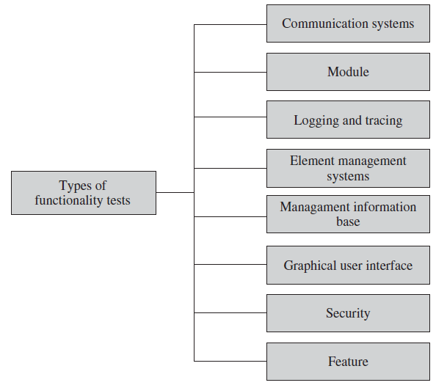
2. Functionality Tests
Functionality tests verify the system as thoroughly as possible over the full range of requirements specified in the requirements specification document.
This category of tests is partitioned into different functionality subgroups as follows:
Communication System Tests
Module Tests
Logging and Tracing Tests
Element Management System Tests
Management Information Base Tests
Graphical User Interface Tests
Security Tests
Feature Tests

Slide 19
a. Communication Systems Tests
Communication systems tests are designed to verify the implementation of the communication systems as specified in the customer requirements specification.
Four types of communication systems tests are recommended according to the extent to which they provide an indication of conformance:
Basic interconnection tests provide evidence that an implementation can establish a basic connection before thorough testing is performed.
Capability tests check that an implementation provides the observable capabilities based on the static communication systems requirements. The static requirements describes the options, ranges of values for parameters, and timers.
Behaviour tests attempt to verify the dynamic communication systems requirements of an implementation. These are the requirements and options that define the observable behaviour of a protocol.
Systems resolution tests probe to provide definite “yes” or “no” answers to specific requirements.

Slide 20
b. Module Tests
Module tests are designed to verify that all the modules function individually as desired within the systems. Mutual interactions among the modules glue these components together into a whole system.
The idea here is to ensure that individual modules function correctly within the whole system. One needs to verify that the system, along with the software that controls these modules, operate as specified in the requirement specification.

Slide 21
c. Logging and Tracing Tests
Logging and tracing tests are designed to verify the configurations and operations of logging and tracing.
This also includes verification of non-volatile flash memory logs when the system crashes.
Tests may be designed to calculate the impact on system performance when all the logs are enabled.

Slide 22
d. Element Management Systems Tests
The EMS tests verify the main functions which are to manage, monitor, and upgrade the communication system network elements (NEs).
An EMS communicates with its NEs by using, for example, the Simple Network Management Protocol (SNMP) and a variety of proprietary protocols and mechanisms.

Slide 23
e. Management Information Base Tests
The MIB tests include verification of the agent within the system that implements the objects it claims to.

Slide 24
f. Graphical User Interface Tests
The GUI tests are designed to verify the interface to the users of an application.
These tests verify different components (objects) such as icons, menu bars, dialogue boxes, scroll bars, list boxes, and radio buttons.
Ease of use (usability) of the GUI design and output reports from the viewpoint of actual system users should be checked. The usability characteristics which can be tested include the following:
Accessibility
Responsiveness
Efficiency
Comprehensibility

Slide 25
Graphical User Interface
Accessibility: Can users enter, navigate, and exit with relative ease?
Responsiveness: Can users do what they want and when they want in a way that is clear? It includes ergonomic factors such as colour, shape, sound, and font size.
Efficiency: Can users do what they want with a minimum number of steps and time?
Comprehensibility: Do users understand the product structure with a minimum amount of effort?

Slide 26
g. Security Tests
Security tests are designed to verify that the system meets the security requirements:
Confidentiality-is the requirement that data and the processes be protected from unauthorized disclosure.
Integrity--is the requirement that data and process be protected from unauthorized modification.
Availability--is the requirement that data and processes be protected from the denial of service to authorized users.

Slide 27
h. Feature Tests
Feature tests are designed to verify any additional functionalities which are defined in the requirement specifications but not covered in the above categories.
Examples of those tests are
Data conversion testing: is testing of programs or procedures that are used to convert data from an existing system to a replacement system. An example is testing of a migration tool that converts a Microsoft Access database to MySQL format.
Cross-functionality testing: provides additional tests of the interdependencies among functions. For example, the verification of the interactions between Network Elements and an element management system in a wireless data network is considered as cross-functionality testing.

Slide 28
Taxonomy of System Tests

Slide 29
3. Robustness Testing
Robustness means how sensitive a system is to erroneous input and changes in its operational environment.
Tests in this category are designed to verify how gracefully the system behaves in error situations and in a changed operational environment.
The purpose is to deliberately break the system, not as an end in itself, but as a means to find error.
It is difficult to test for every combination of different operational states of the system or undesirable behaviour of the environment.

Slide 30
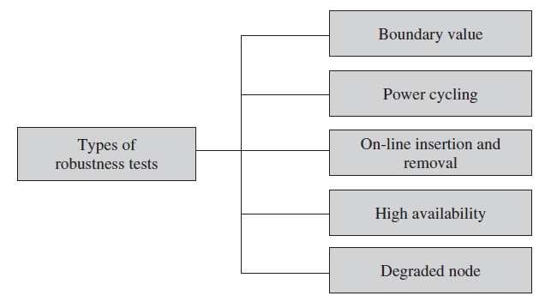
Robustness Testing
Hence, a reasonable number of tests are selected from each group given below:
Boundary Value
Power Cycling
Online Insertion and Removal
High Availability
Degraded Mode

Slide 31
a. Boundary Value Tests
Boundary value tests are designed to cover boundary conditions, special values, and system defaults.
The tests include providing invalid input data to the system and observing how the system reacts to the invalid input. The system should respond with an error message or initiate an error processing routine.
It should be verified that the system handles boundary values (below or above the valid values) for a subset of configurable attributes.

Slide 32
b. Power Cycling Tests
Power cycling tests are executed to ensure that, when there is a power glitch in a deployment environment, the system can recover from the glitch to be back in normal operation after power is restored.
As an example, verify that the boot test is successful every time it is executed during power cycling.

Slide 33
d. On-Line Insertion and Removal Tests
On-line insertion and removal (OIR) tests are designed to ensure that on-line insertion and removal of modules, incurred during both idle and heavy load operations, are gracefully handled and recovered.
The system then returns to normal operation after the failure condition is removed.
The primary objective is to ensure that the system recovers from an OIR event without rebooting or crashing any other components.
OIR tests are conducted to ensure the fault-free operation of the system while a faulty module is replaced.
As an example, while replacing an Ethernet card, the system should not crash.

Slide 34
d. High-Availability Tests
High-availability tests are designed to verify the redundancy of individual modules, including the software that controls these modules.
The goal is to verify that the system gracefully and quickly recovers from hardware and software failures without adversely impacting the operation of the system.
The concept of high availability is also known as fault tolerance. High availability is realized by means of proactive methods to maximize service up-time and to minimize the downtime.
One module operates in the active mode while another module is in the standby mode to achieve 1+1 redundancy.

Slide 35
High-Availability Tests
For this mode of operation, tests are designed to verify the following:
A standby module generates an OIR event, that is, hot swapped, without affecting the normal operation of the system.
The recovery time does not exceed a predefined limit while the system is operational. Recovery time is the time it takes for an operational module to become a standby module and the standby module to become operational.
A server can automatically switch over from an active mode to a standby mode in case a fail-over event occurs. A fail-over is said to occur when a standby server takes over the workload of an active server.

Slide 36
e. Degraded Node Tests
Degraded node (also known as failure containment) tests verify the operation of a system after a portion of the system becomes nonoperational.
It is a useful test for all mission-critical applications.
Examples of degraded node tests are as follows:
Cut one of the four T1 physical connections from one router to another router and verify that load balancing occurs among the rest of the three T1 physical connections. Confirm that packets are equally distributed among the three operational T1 connections.
Disable the primary port of a router and verify that the message traffic passes through alternative ports with no visible interruption of service to end users. Next, reactivate the primary port and verify that the router returns to normal operation.

Slide 37
Taxonomy of System Tests
DONE
NEXT LECTURE

